Slide 1
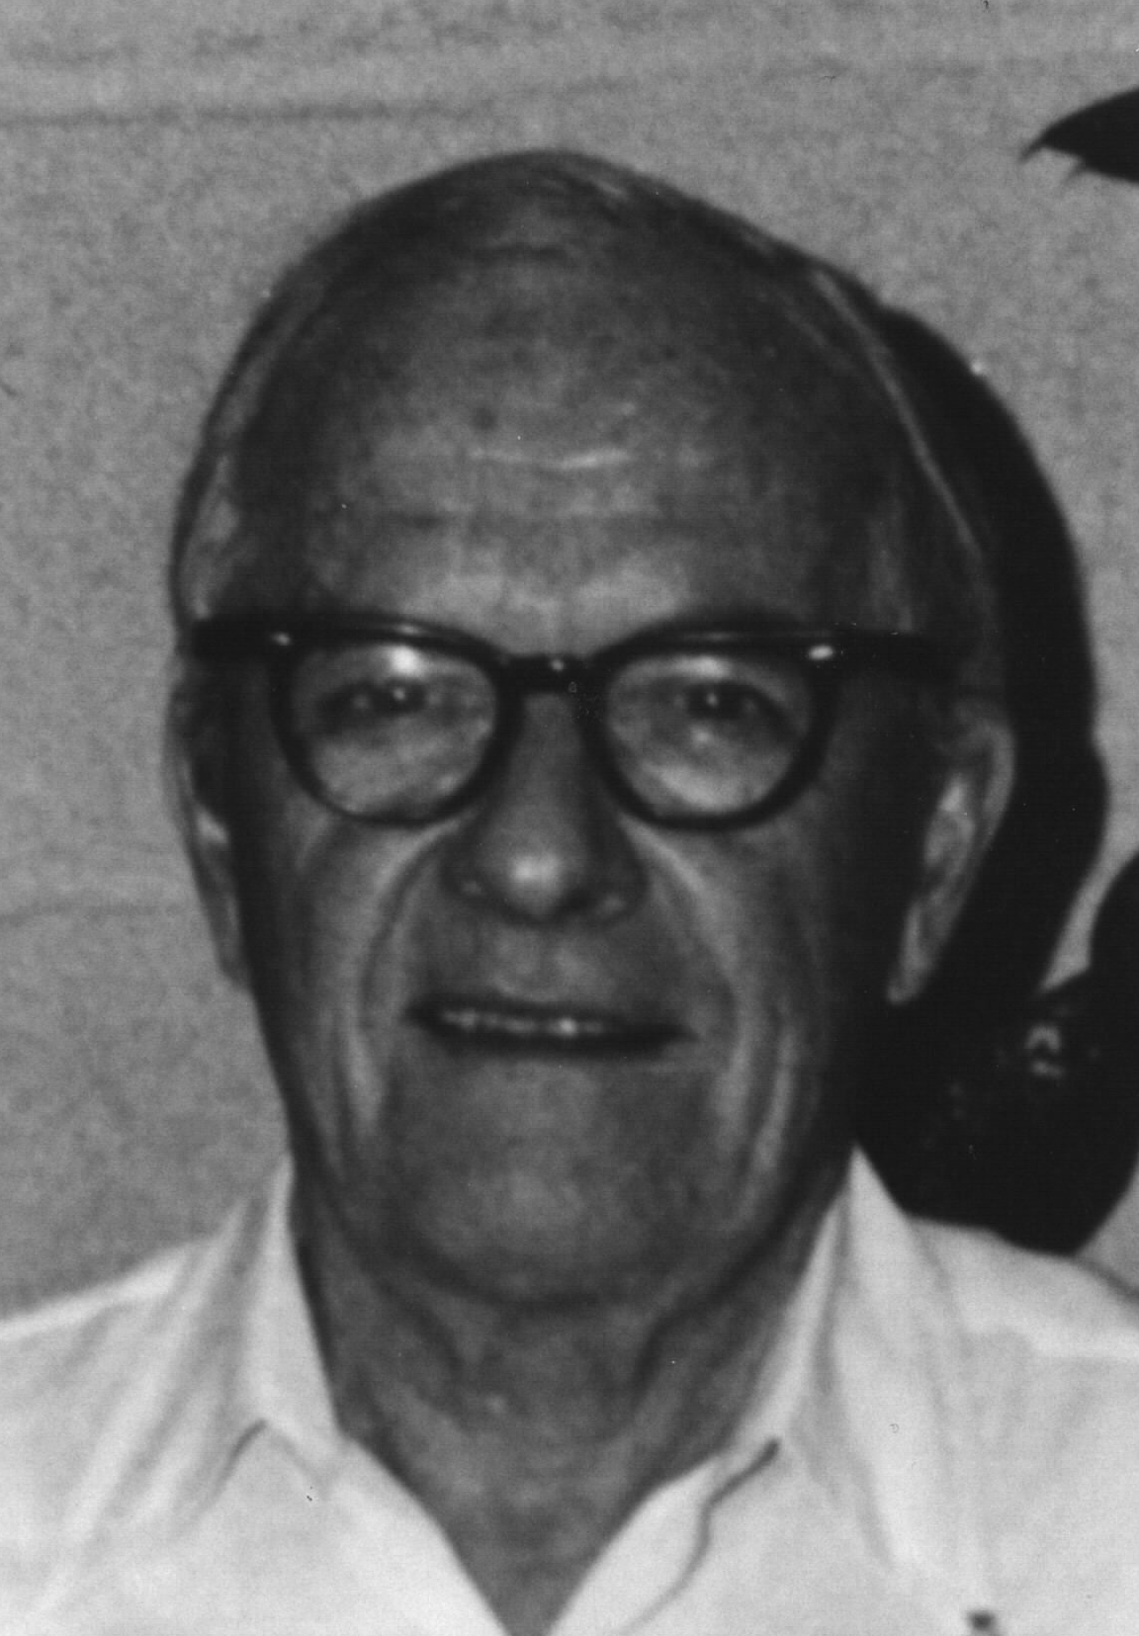
The David Sinclair Award
American Association for Aerosol Research

Slide 2
The award memorializes David Sinclair, one of aerosol science’s great innovators, known for his knowledge, ingenuity and energy.
The David Sinclair Award “recognizes sustained excellence in aerosol research and technology by an established scientist still active in his/her career. The individual’s research must have a lasting impact in aerosol science”.

Slide 3
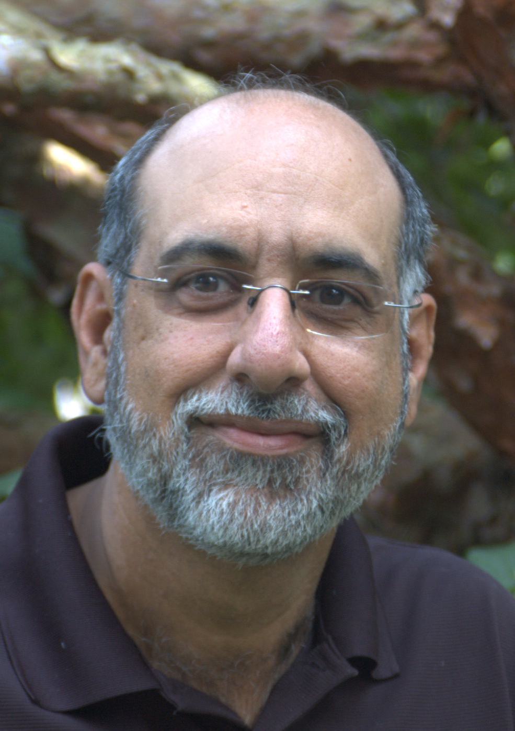
2011 Recipient of the David Sinclair Award
Michael R. Zachariah
University of Maryland and National Institute of Standards and Technology
Nominated by Prof. Peter H. McMurry
Ph. D., University of California, Los Angeles, Chemical Engineering, 1986
Author of more than 227 peer-reviewed journal papers cited over 3,000 times to date
“…. Mike’s knowledge of reaction kinetics lead to his pioneering efforts to integrate aerosol dynamics with chemical kinetics.”
“I have … enjoyed studying … his molecular simulation studies. The one on particle sintering … is indeed a masterpiece.”
“… combines theoretical studies of the fundamental physical chemistry of aerosol nanoparticles with advances in the state of the art in aerosol measurement …”

